Slide 2
Depressão

Slide 3
Mapa da sessão
Introdução à depressão
Avaliação da depressão
Manejo da depressão
Seguimento
Revisão
Notes:
Begin the session by briefly listing the topics that will be covered.

Slide 4
Atividade 1: História pessoal seguida de discussão em grupo
Apresente o relato em primeira pessoa de alguém que vive com depressão
História pessoal: Vídeo 02 “Black Dog” - Cachorro sombrio
Primeiros pensamentos.
Notes:
How to use the person story technique. Choose one story from the DEP supporting material (person stories 1/2/3).
1) Introduce the activity and ensure participants have access to pens and paper.
2) Tell the story – be creative in how you tell the story to ensure the participants are engaged.
3) First thoughts – allow participants time to give their immediate thoughts on what they have heard. Encourage them to reflect on what it may feel like to live with depression and how depression impacts on a person’s life.

Slide 5
Descrições locais de depressão
Quais são os termos/nomes locais para depressão?
Como pessoas com depressão são tratadas e percebidas pela comunidade local?
Notes:
Facilitate a brief group discussion in plenary (maximum five minutes) about local terms and descriptions used to describe depression.
Gather a consensus about how people with depression are treated and perceived by the local community.
Make a note of the group’s answers on flip chart or black/white board.

Slide 6
Principais sintomas de depressão
Humor deprimido e/ou falta de energia persistente.
Acentuada diminuição de interesse ou prazer nas atividades.
Notes:
Remind participants of the descriptions of symptoms they heard in the first person account at the beginning of the session.
Highlight the two core symptoms of depression – persistent low mood and diminished interest in, or pleasure from, activities.
Encourage participants to think of any presentations and then show the next slide.

Slide 7
Manifestações comuns de depressão
Múltiplos sintomas físicos persistentes sem causa evidente
Baixa energia
Fadiga
Problemas de sono (dormir demais ou pouco)
Ansiedade
Alteração significativa do apetite ou peso (ganho ou perda de peso)
Crenças de inutilidade
Culpa excessiva
Indecisão
Inquietação/agitação
Desesperança
Pensamentos e atos suicidas
Notes:
Encourage participants to think of any presentations that are not included in the list and/or expand on any of these presentations from personal/professional experiences of interacting with someone with depression.

Slide 8
Fatores contribuintes
Biológicos
Psicológicos
Sociais
Notes:
Explain that depression results from a complex interaction of social, psychological and biological factors.
For example, explain that people who have gone through adverse life events (unemployment, bereavement, psychological trauma) are likely to develop depression. Their depression can, in turn, lead to the person experiencing more stress and dysfunction (such as social isolation, indecisiveness, fatigue, irritability), thus worsening the person’s life situation and the depression itself. Biological factors may contribute to a person developing depression, such as a person with a family history of depression.

Slide 9
Identificando a depressão
A duração do tempo durante o qual uma pessoa vivencia os sintomas é uma das distinções entre depressão e humor deprimido em geral.
Por quanto tempo você acha que os sintomas devem estar presentes?
Notes:
Identifying depression
Explain that differentiating between depression and low mood is an important skill.
Low mood is normal and transient; many people experience low mood from time to time.
Depression lasts longer and has a profound impact on a person’s ability to function in everyday life.
Therefore, when identifying depression, it is important to consider both:
The duration of the symptoms; and
The effect on daily functioning.
Ask the participants to think back to the story they heard at the beginning of the session and any knowledge they have from their own experience of working with people with depression and consider how long the symptoms have been present. Explain that they can use their mhGAP-IG to find the answer.
Explain that to identify depression, symptoms must be present for at least two weeks.

Slide 10
Identificando a depressão
Depressão significa que há um prejuízo considerável na capacidade funcional diária de uma pessoa.
Algumas pessoas podem experimentar um humor deprimido persistente, mas podem continuar funcionais na vida diária. Portanto, os seus sintomas não constituem depressão e podem ser manejados através do Módulo: Outras queixas significativas em saúde mental na versão 2.0 do MI-mhGAP.
Notes:
Identifying depression
Explain that depression has a significant impact on the person’s ability to function in daily life. In many cases depression can reduce a person’s ability to carry out daily tasks such as cooking, cleaning, washing etc.
Those with depression may struggle with getting out of bed and/or engaging in any activities of daily living.
If a person is experiencing persistent low mood but continues to function in their everyday life then they have symptoms not amounting to depression, which is covered within the Module: Other significant mental health complaints.

Slide 11
Impacto socioeconômico
Alto desemprego
Agravamento das condições de vida
Altas taxas de prevalência
322 milhões de pessoas no mundo todo
4,4% na comunidade
10-20% em atendentes de atenção primária
10% em mulheres que deram à luz
Deficiência e mortalidade
Principal causa de incapacidade
Altas taxas de suicídio
Depressão:
Uma prioridade
de saúde
pública
Impacto nas famílias
Desenvolvimento infantil
Relações familiares
Educação dos filhos
Correlações com outras condições de saúde física
Doenças não transmissíveis
Doenças transmissíveis
Notes:
Explain to participants that depression is a public health priority. Explain the prevalence rates stated in the slide:
1) It is estimated that more than 322 million people worldwide suffer from depression, resulting in a prevalence rate of 4.4% in the general community and accounting for 10–20% of people who attend primary health-care clinics.
There is at least a 10% prevalence rate of depression amongst women who have given birth. This is called post-partum depression.
2) Emphasize that by 2030, depression is expected to be among the diseases with the highest burden everywhere in the world. The term “burden” reflects both mortality and disability.
Mental disorders are extremely disabling, causing many people not to function well in their daily lives.
3) Explain that depression impacts on family life, including child development (infant growth), family relationships and the way parents raise their children.
4) Explain the socioeconomic impacts. People with depression are often unable to work, leading to high levels of unemployment; families may lose the main breadwinner, therefore the family’s living conditions may deteriorate.
Also, as will be discussed in the next slide, depression is correlated with other physical health conditions.
All this makes depression an important public health concern in all countries.

Slide 12
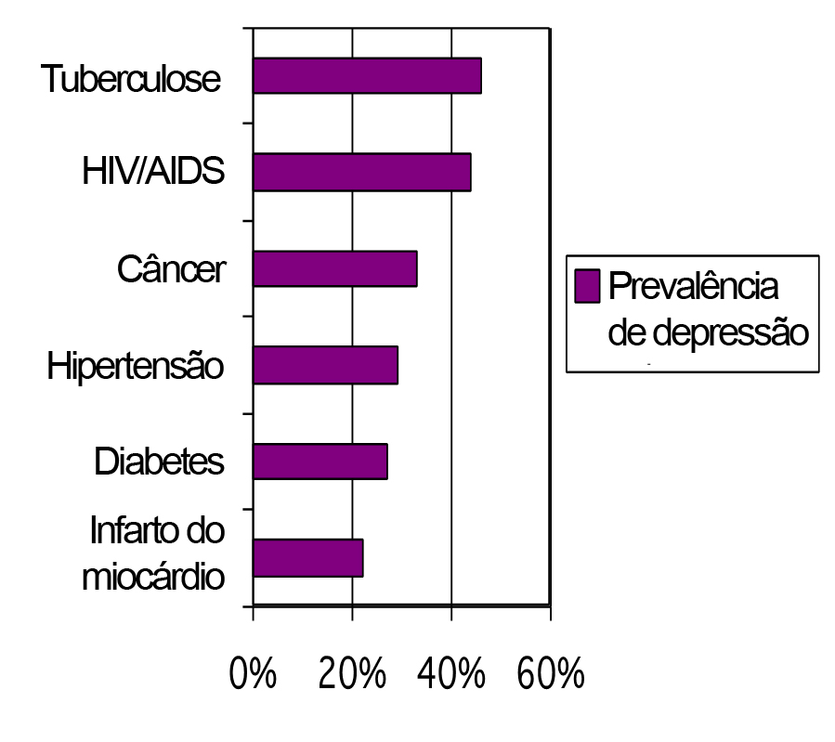
Prevalência média de depressão em pessoas com doenças físicas (70 países)
Notes:
Explain that the relationship between depression and physical health is particularly important to focus on in non-specialized health settings.
Physical conditions can often manifest themselves first, and, if health-care providers only focus on the physical symptoms, the real cause of the problem may go undetected.
Describe the findings on the slide. Highlighting the prevalence of:
Co-occurring conditions such as diabetes, TB, HIV/AIDS, cancer, hypertension, myocardial infarction.
Explain that research has also shown that depression can:
Predispose people to other conditions, e.g. myocardial infarctions.
Depression can also reduce adherence to treatment for chronic diseases including HIV and TB.
Ask the group to share experiences in their clinics of times when they observed someone with depression and a co-morbid physical condition.

Slide 13
Notes:
Direct participants to the master chart in the mhGAP-IG Version 2.0 (page 16).
Review the common presentations.
Ask participants to think about how easy or hard it would be to identify depression in their practice?

Slide 14
Notes:
Instruct participants to turn to the assessment page in the mhGAP-IG Version 2.0 (page 20).
Describe the principles of assessment for depression as on the slide.

Slide 15
Atividade 2: Exibição de vídeo: Avaliação
Exiba o vídeo 03 de avaliação da depressão MI-mhGAP.
Notes:
Explain to participants that you are going to show them a video of “Sarah” being assessed for depression. During the video, ask the participants to scan the depression assessment algorithm in the mhGAP-IG Version 2.0 (page 21) to follow the assessment and then discuss it.

Slide 16
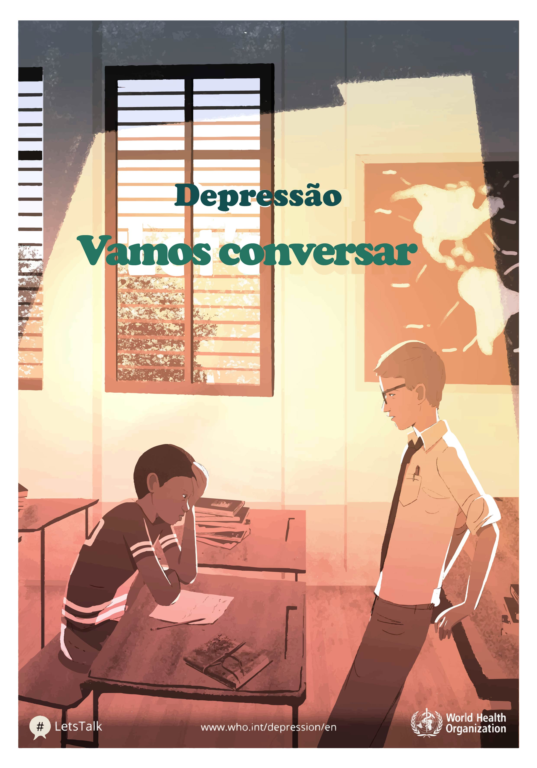
Notes:
After the video – explain that:
Depression may not always be obvious.
The person often does not know about their condition.
It is not always necessary to use the term depression to explain what they are experiencing, rather use their own words and their own descriptions to make it easier for them.
Patience, trust and a good relationship with the person is essential to identifying depression. Use effective communication skills to understand what is happening to the person. (Remind participants of the skills taught in Module: Essential care and practice).
Although depression is common, it can be hard to identify.
Discuss the assessment algorithm in the mhGAP-IG.

Slide 17
Processo de avaliação no vídeo
Notes:
In plenary, use the mhGAP-IG algorithm to decide:
Does Sarah have depression?
Did Sarah have at least one of the core symptoms of depression in the past two weeks?
Seek group consensus.
Ask the group how the health-care provider found out how long the symptoms lasted?

Slide 18
Notes:
Ask the group if Sarah had any of the additional symptoms in the past two weeks?
Concepts such as “reduced concentration” can be difficult to express. During assessment, ask about activities that require good concentration, such as cooking a meal, reading, listening, watching TV, reciting prayers etc.
Did Sarah have considerable difficulty with daily functioning in personal, family, social, educational, occupational or other areas?
If participants struggle to identify difficulties with daily functioning in the video, remind them that Sarah said, “The little one is only one. I hardly feed and clean her or play with her anymore! Not only that but I am not cooking or cleaning the house either.”
Ask participants to suggest questions they could ask to find out this information.

Slide 19
O caso de Ana
Ana tem 23 anos e tem um bebê em casa.
O que mais queremos saber:
Ela está amamentando?
Ela está gravida?
O bebê está se desenvolvendo bem?
Notes:
Highlight to the group that in Sarah’s case we learned that she had a baby at home.
Ask this question before revealing the answers: With that knowledge, what other information do we want to know about Sarah?
After receiving a few answers from the participants, reveal the answers on the slide and then explain that: If the woman is breastfeeding or pregnant, it may change the decision regarding medications.
Explain that there are “special populations” (turn to page 26 of mhGAP-IG) for whom interventions may differ, such as women who are pregnant or breastfeeding.
Ask participants why they think that is?
Explain that children and adolescents are considered a special population and to understand the presentation and management of depression in children and adolescents you need to go to the Module: Child and adolescent mental and behavioural disorders in mhGAP-IG.

Slide 20
Considere as condições físicas
Notes:
Ask the group: How did the health-care provider rule out other possible explanations for the symptoms?
Remind participants that Sarah had her own understanding of what might be happening to her – that she had cancer.
Is this possible? How would you check for this?

Slide 21
Condições físicas que se assemelham a depressão
Condição
Sintomas
Anemia
Desnutrição
Hipotireoidismo
Cansaço, perda de energia, problemas de sono, dores físicas, problemas de concentração.
Cansaço, perda de energia, perda de apetite, falta de interesse em alimentos e bebidas, falta de concentração, humor deprimido, sensação de fraqueza.
Cansaço, dores musculares e sensação de fraqueza, alterações no apetite (ganho de peso), humor deprimido, problemas de memória e concentração (raciocínio lento), perda de libido, perda de energia.
Notes:
Emphasize again that there are challenges in identifying depression.
Explain that there are several other conditions that resemble depression. Therefore, it may take a number of meetings to establish if the person has depression.
Describe the symptoms of anaemia, malnutrition and hypothyroidism and how they resemble depression (as described in the slides).
Ask participants to reflect on ways they could mitigate the risk of missing depression.
Explain that a thorough psychosocial, medical and mental health assessment is essential. Regular follow-up will help to ensure that the correct identification is made.

Slide 22
Notes:
Continue with the assessment algorithm in the mhGAP-IG.
Explain that depression can be present as a part of bipolar disorder.
Explain that bipolar disorder is characterized by episodes in which a person’s mood and activity level are significantly disturbed. The symptoms are reflected on the slide and in page 24 of the mhGAP-IG.
Ask if participants have taken care of someone with mania in the past. What are the symptoms?
Give an example of the common presentation of someone with mania – in the form of a person’s story (see DEP supporting material person story 4).
After the person’s story, discuss the symptoms of mania that the person demonstrated.
Explain that depression and mania can follow one another together in the form of bipolar disorder. This will be discussed in more detail in the Module: Psychoses.

Slide 23
Notes:
Explain that in addition to ruling out a history of mania, assess whether there has been a major loss (bereavement) in the past six months. A normal grief reaction could account for the symptoms the person is experiencing.

Slide 24
Luto
Humor deprimido, ansiedade, medo, culpa, autocobrança, irritabilidade, solidão, choro.
Pensamento negativo, ruminação, baixa autoestima, desesperança, pessimismo em relação ao futuro.
Isolamento social, desinteresse, inquietação, agitação.
Perda de apetite, problemas para dormir, perda/aumento de apetite, dores físicas, cansaço, perda de energia.
Notes:
Depression and grief
Explain that grief is a normal reaction to loss. Many people who experience grief report feeling similar symptoms to depression.
Describe the common experiences of grief as shown on the slide.
Explain that grief and people who are grieving are examples of why it is important to be open, non-judgemental and attentive to the other person’s experience to fully understand the problem.
Responding to a significant loss with grief is normal and the person should be supported to grieve in culturally appropriate ways.

Slide 25
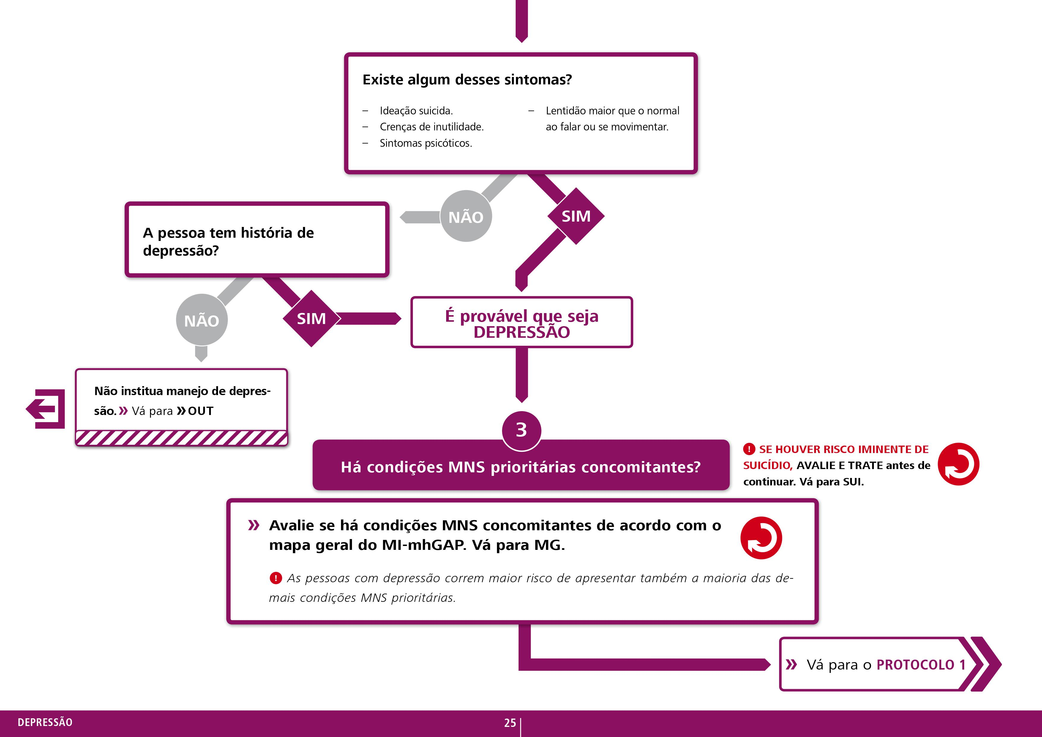
Notes:
Emphasize that grief must be considered if:
Symptoms last more than six months;
Severe symptoms are present – as listed in the slide and mhGAP-IG page 25; and
There is previous history of depression.

Slide 26
O caso de Ana
O profissional de saúde avaliou o histórico de mania de Ana?
Quais perguntas poderiam ter sido usadas para investigar se ela havia experimentado algum desses sintomas?
O profissional de saúde avaliou se Ana sofreu uma perda importante nos últimos seis meses? Em caso afirmativo, quais perguntas você poderia ter feito?
Notes:
Bring the group’s focus back to the assessment of Sarah that they saw in the video and ask the questions on the slide.
Make a note of any appropriate questions suggested by participants, as they can use these during the role plays.

Slide 27
Notes:
Assessing for self-harm/suicide
Point out the instruction in the algorithm to ask and assess for an imminent risk of suicide and ask participants: How did the health-care provider address suicide?
Explain that depression can be associated with suicide.
The assessment and management of self-harm/suicide will be covered in detail later in the training.

Slide 28
Avalie o risco iminente de suicídio
Falar sobre autoagressão/suicídio é ESSENCIAL.
Falar sobre autoagressão/suicídio NÃO aumenta o risco de que a pessoa cometerá autoagressão/suicídio.
Se houver risco de autoagressão/suicídio, VÁ IMEDIATAMENTE PARA O MÓDULO: AUTOAGRESSÃO/SUCICÍDIO NO MI-mhGAP E SIGA OS PASSOS PARA MANEJO DE AUTOAGRESSÃO/SUCICÍDIO.
Notes:
For now it is important to know the three points in the slide.
Having emphasized these points, return to discussing Sarah’s case and say: In Sarah’s case she has emotional distress, she is very tearful and feels hopeless. Should we ask about suicide?

Slide 29
Notes:
Continue discussing the video assessment with Sarah and ask participants: Did Sarah have any other co-occurring priority MNS conditions?
Explain that if participants suspect any other concurrent priority MNS conditions, they should use the master chart and identify which condition they suspect and use the mhGAP-IG to assess and manage that condition.

Slide 30
Avaliação de depressão
Uma pessoa com fadiga, falta de sono e perda de peso vem para ser atendida por um prestador de cuidados de saúde.
Sigamos o MI-mhGAP para avaliar alguém quanto a uma possível depressão.
Notes:
See DEP supporting material role play 1.
Print off three different instruction sheets for the participants playing different roles.
Ensure the person playing the role of the observer also has a competency assessment form (see ToHP training forms) in order to assess the participants.
Duration: 30 minutes.
Purpose: This role play gives participants an opportunity to practise using the mhGAP-IG to assess for possible depression.
Situation:
A person with fatigue, poor sleep and weight loss comes to see health-care provider.
Instructions:
Divide the participants into groups of three.
Instruct one person to play the role of the health-care provider, one to play the role of the person seeking help and one to play the role of the observer.
Distribute the role play instructions to each person depending on their role.
Ensure that the participants keep to the allotted time.

Slide 31
Notes:
Management of depression
Direct participants back to the final stage of the assessment algorithm in the mhGAP-IG (p 25)
Explain that if the assessment leads to the conclusion that the person has depression, they should go to Protocol 1 in the mhGAP-IG (page 26).

Slide 32
INTERVALO

Slide 33
Atividade 3: Exibição de vídeo: Manejo da depressão
Você verá agora o Vídeo 04 que mostra o profissional de saúde manejando a depressão de Ana (parte 2). Enquanto assiste ao vídeo, pense em:
Como o profissional de saúde explicou as opções de tratamento disponíveis?
O profissional de saúde explicou os riscos e benefícios de diferentes intervenções de tratamento?
Notes:
Show part 2 of the mhGAP-IG video “managing depression”.
While watching, ask participants to think about the questions on the slide.

Slide 34
Notes:
Briefly let the participants read through Protocol 1 and move on to the next slide.

Slide 35
Notes:
Remind participants how the management “hand” works (described when teaching Module: Essential care and practice).
Explain that choosing the appropriate intervention is the first step to developing a treatment plan with the person.
Ask participants to name some of the interventions they could use for depression according to the ECP module.
Give the participants a few minutes to suggest some interventions before moving on.

Slide 36
Promoção do funcionamento em atividades diárias
Tratamento psicológico breve para depressão
Redução do estresse
e fortalecimento do apoio social
Farmacologia
Psicoeducação
Notes:
Explain the management for a person with depression.
Explain that depending on the person you are caring for, you can use one or two of these interventions, or you can use all five.
The choice of intervention will depend on a collaborative discussion with the person.

Slide 37
Planos de tratamento devem incluir:
Apresentando o problema: Quais são as necessidades sociais e de saúde da pessoa?
Quais intervenções atendem melhor as necessidades sociais e de saúde da pessoa?
Plano de ação: Registre as etapas, metas e comportamentos que precisam acontecer, quem os executará e quando?
Manejo de riscos (planos para o que pode ser feito durante uma crise).
Envolva a pessoa e os cuidadores para garantir a propriedade do plano de tratamento.
Notes:
Explain to participants that for the best results, it is essential to involve the person in developing the treatment plan (remind participants of the discussions from the Module: Essential care and practice on treatment planning).
Talk through each point on the slide using the notes below.
A treatment plan sets out:
The presenting problem, including the person’s health and social needs. For example, does the person have a physical condition in addition, which needs medical attention; does the person need help in accessing social supports, etc.
Which interventions will be used for which needs and why?
Actions – record what actions and behaviours need to happen and who will do them.
Is a tool for managing risk – plans for what people can do in a crisis, and a plan which can be used and understood by the individual and their families, carers and other agencies, as well as colleagues, in a crisis.
Involves the person so it is something which people feel they own and can engage with. If the person with depression and their carer understands what you are trying to do, they are more likely to do it. So, involve them.
A treatment plan must be based on a thorough assessment of need. This is true for both psychosocial and pharmacological interventions.

Slide 38
Quando encaminhar?
Considere encaminhar para um especialista em saúde mental (quando disponível):
Se uma pessoa com depressão apresentar algum sinal de sintomas psicóticos (por exemplo, alucinações e delírios).
Se a pessoa apresentar transtorno bipolar.
Se a pessoa estiver grávida ou amamentando.
Nos casos de pessoas que cometeram autoagressão/tentativa de suicídio.
Se a pessoa não responde ao tratamento.
Se a pessoa apresenta efeitos colaterais graves de quaisquer intervenções farmacológicas.
Considere encaminhar para uma emergência:
Se a pessoa precisar de tratamento adicional para uma condição física comórbida (emergência).
Se existe o risco atual e iminente de suicídio.
Notes:
Before showing this slide:
Ask participants: When should they consider a referral to a mental health specialist? Wait to hear a few answers from participants and then discuss the points described in the slide.
Then ask participants: When would they consider referring someone with depression to a hospital? Wait for a few answers then discuss the points of the slide.
It is also useful to ask participants to identify relevant specialists and hospitals in their area.

Slide 39
Conexão com outros serviços
Vincular pessoas a outros serviços garante:
Que a pessoa receba um pacote abrangente de cuidados.
Cumpre partes das intervenções psicossociais, como para promover o funcionamento nas atividades diárias e na vida comunitária. Se a pessoa identificou que gostaria de retornar aos estudos e/ou iniciar uma atividade de trabalho, é importante vinculá-la a tais organizações.
Notes:
Explain that delivering psychosocial interventions requires linking people with other organizations, especially if the person indicated an interest in engaging with any educational, social, legal, educational or livelihood support.
Ask the participants to brainstorm and come up with organizations in their local setting that they could refer to. Give them five minutes to do this.

Slide 40
Intervenções psicológicas breves
Como terapia de primeira linha, os profissionais de saúde podem optar por tratamentos psicológicos e/ou medicação antidepressiva.
Ao decidir, eles devem ter em mente:
Os possíveis efeitos adversos da medicação antidepressiva.
A capacidade de fornecer qualquer intervenção (em termos de especialização e/ou disponibilidade de tratamento).
As preferências individuais da pessoa.
Notes:
Explain that mhGAP-IG recommends brief psychological treatments as first-line treatments for depression.
These interventions need to be delivered by trained individuals and the person should be supervised.
Explain that next we will have a look at brief psychological treatments recommended by WHO.
Explain that such brief interventions are not available in many settings yet.
Ask the participants what psychological treatments are available in their settings.
Then provide a description of WHO brief psychological treatments in the next few slides.

Slide 41
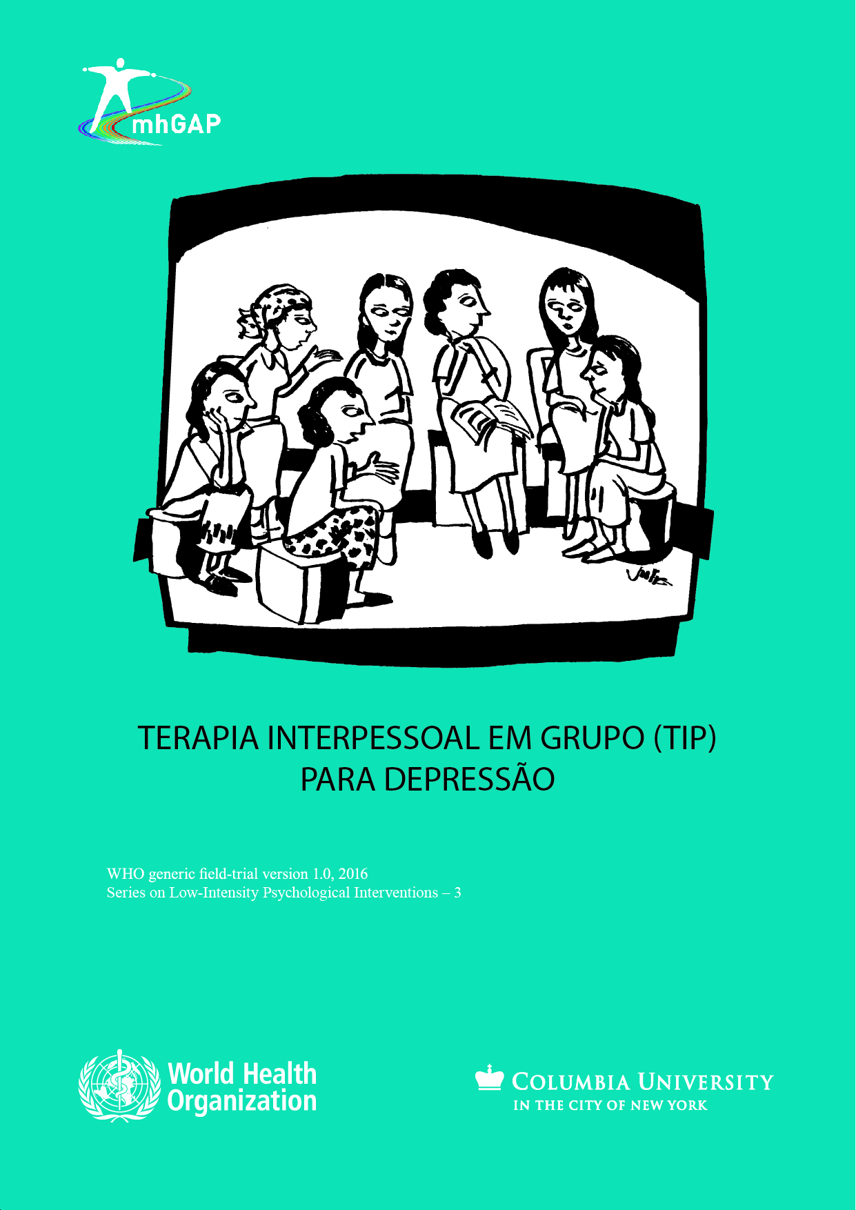
Terapia interpessoal de grupo (TIP)
Assume que a depressão é desencadeada por dificuldades interpessoais em uma ou mais áreas problemáticas:
luto
disputas interpessoais
transições de função
déficits interpessoais.
Ao entender a relação entre os eventos interpessoais e o estresse, e ajudando a pessoa a melhorar suas habilidades para lidar com esses eventos, podemos ajudá-la a se recuperar.
Notes:
Using the points on the slide explain briefly what group interpersonal therapy is.

Slide 42
Técnicas de Terapias Cognitivo-Comportamentais
Aconselhamento para resolução de problemas
Manejo do estresse (respiração lenta)
Ativação comportamental
Fortalecimento dos apoios sociais
Notes:
Explain that PM+ includes a variety of strategies such as the principles of behavioural activation to have people schedule activities that they may have been avoiding in order to improve their mental well-being.
Behavioural activation involves planning and scheduling pleasant activities that people may have been avoiding, to improve mental well-being.

Slide 43
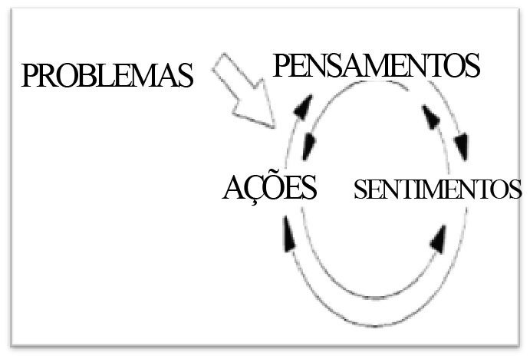
Pensamento saudável – terapia cognitivo-comportamental para depressão pós-parto
Notes:
Explain that “thinking healthy” uses the principles of cognitive behavioural therapy (identifying the relationship between thoughts, behaviour and feelings) to treat women with perinatal depression.

Slide 44
Notes:
Direct participants to mhGAP-IG Version 2.0 page 28 point 2.5 (Consider antidepressants).
Have a participant read aloud the points described in the mhGAP-IG.
Highlight the importance of discussing whether to start antidepressants or not, together with the person.
The person should be involved in the decision-making process and understand the risks and benefits of taking medication.
Explain how important it is that people understand how to take medication properly and safely.
They should know what to expect when taking medication, e.g. any side-effects, when to expect to see an improvement etc.

Slide 45
Intervenções farmacológicas: Quando NÃO prescrever
Não prescreva se a criança tiver menos de 12 anos.
Não prescreva para adolescentes com idade entre 12 e 18 anos como tratamento de primeira linha. Ofereça primeiro intervenções psicossociais (a depender da gravidade).
Não prescreva um antidepressivo se não houver depressão. Por exemplo:
Quando os sintomas não duram duas semanas (quando não for moderada a grave) e não envolvem comprometimento funcional.
Se os sintomas são parte de uma reação normal de luto.
Se os sintomas são devidos a uma causa física identificada e tratável.
Notes:
Discuss the points on the slide individually, ensuring that people understand when NOT to prescribe antidepressants.
Explain that antidepressants can have adverse side-effects. Refer to Table 1 on page 29.
Antidepressants require that the person stays on them for a long time as advised by the health-care provider and this does not suit everyone.
45

Slide 46
Notes:
Direct participants to page 29 of mhGAP-IG (Table 1: Antidepressants).
Look through the lists of WHO essential medications.
Ask participants to read the table carefully and ask any questions. Give this 10 minutes if needed.
Gain an understanding from participants on how often they have used these medications and if there is a regular supply in their primary health care facility.
Make a note of their answers as this is useful information to follow-up on in supervision.

Slide 47
Precauções para antidepressivos tricíclicos (ATC)
Evite o uso em:
Idosos (amitriptilina), pessoas com doença cardiovascular (distúrbio de condução), glaucoma, hiperprostatismo e pessoas com demência.
Pessoas com ideias, planos ou atos anteriores de autoagressão ou suicídio – para minimizar o risco de superdosagem.
Notes:
Use the points on the slide to explain when to avoid using tricyclic antidepressants.
In the elderly, people with cardiovascular disease and people with dementia.
People with ideas, plans or previous acts of self-harm or suicide – to minimize the risk of overdosing.
Explain that the participants should ask the family to monitor the doses of TCAs in people with risk of self-harm/suicide, as people may hide the tablets and take them all at once as a way of overdosing.

Slide 48
Escolhendo um antidepressivo apropriado
Hora das perguntas
Notes:
Direct participants to pages 28 and 29 in the mhGAP-IG Version 2.0 and answer these questions:

Slide 49
Atividade 4: Role Play da depressão : Intervenções psicossociais
Um jovem de 27 anos foi identificado como tendo depressão há uma semana. Um ano atrás, ele trabalhava em um banco movimentado prestes a ser promovido e de casamento marcado.
Então sua noiva o deixou, inesperadamente, por outra pessoa. Ele sentiu o estresse do trabalho e começou a se sentir muito ansioso e preocupado o tempo todo. Deixou de conseguir dormir ou comer bem. Sentia-se cada vez mais triste e deprimido. Sua personalidade começou a mudar; ele estava irritável, esquecido, socialmente isolado e incapaz de passar tempo com a família e os amigos pois sentia-se envergonhado e culpado. Ele não tinha trabalho nem renda e se culpava por tudo o que acontecera em sua vida.
Use o MI-mhGAP para desenvolver um plano de tratamento usando intervenções psicossociais.
Notes:
See DEP supporting material role play 2.
Print off three different instruction sheets for the participants playing different roles.
Ensure the person playing the role of the observer also has a competency checklist in order to assess the participants.
Duration: 30 minutes.
Purpose: This role play will give participants an opportunity to practise delivering psychosocial management interventions to a person suffering with depression.
Instructions:
Divide the participants into groups of three.
Instruct one person to play the role of the health-care provider, one to play the role of the person seeking help and one to play the role of the observer.
Distribute the role play instructions and competency assessment form to each person depending on their role.
Ensure that the participants keep to the allotted time.
Situation:
A 27-year-old was identified as having depression one week ago.
One year ago he was employed in a busy bank and really enjoyed the job.
He was in line for a promotion.
He was in a relationship, engaged to be married and was really excited about the future.
Then his fiancée left them, unexpectedly, for another person.
He felt that the stress of work and the impending promotion was too much, and he started to feel very anxious and worried all the time.
He stopped being able to sleep or eat well.
As his mood deteriorated and he felt more and more sad and depressed, his personality started to change. He was irritable, forgetful and within weeks he had damaged his reputation at work to the point that he was fired.
That was one year ago.
Since then he has been very depressed. He is socially isolated, feeling unable to spend time with friends and family as he is embarrassed and ashamed about how his life has changed.
He has no work and has money problems.
He blames himself for everything that has happened in his life.

Slide 50
Notes:
Ensure participants have their mhGAP-IG Version 2.0 open on page 30.
Emphasize that a crucial part of managing depression is ensuring that the participants are able to monitor and follow-up with the person with depression.
Highlight the clinical tip and explain the recommended frequency of contact.
Explain that at every follow-up session they must assess for any improvement or deterioration in the person’s condition.

Slide 51
Possíveis manifestações no seguimento
No seguimento, você pode ver a pessoa:
Melhorar (engajada ativamente em intervenções de manejo e melhorando seus sintomas).
Permanecer a mesma (engajada ativamente em intervenções de manejo, mas seus sintomas permanecem os mesmos) ou se deteriorar (os sintomas estão se deteriorando e a pessoa está se sentindo pior).
Notes:
Explain that at each follow-up session they may see the person either improving or remaining the same/deteriorating.
Whichever is the case, it is essential to keep communicating with the person and be flexible, adapting the intervention options as much as possible.

Slide 52
Notes:
Direct participants to mhGAP-IG Version 2.0 (page 30) and ask them to follow the algorithm as they watch the video.

Slide 53
Monitoramento de pessoas em uso de antidepressivos
Espera-se que as pessoas tenham uma resposta positiva, mas existem alguns resultados que exigirão ação – se a pessoa apresentar:
sintomas de mania
resposta inadequada
nenhuma resposta.
Notes:
Explain that if prescribing antidepressants, the participants should use the principles of psychoeducation to ensure that the individual and the carer understand the risks, benefits, how to take the medication, and what signs to look out for and monitor.
Talk through the points on the slide.

Slide 54
O que fazer quando os sintomas pioram ou não melhoram após quatro a seis semanas (resposta inadequada)?
Tome três passos importantes antes de aumentar a dose:
Certifique-se de que a avaliação esteja correta.
Certifique-se de que a pessoa está tomando a medicação conforme prescrito.
Certifique-se de que a dose é adequada.
Se não houver melhora após quatro a seis semanas na dose máxima, consulte um especialista.
Notes:
Explain that it usually takes approximately four to six weeks to feel the benefits of the medication.
If, however, a person does not experience any improvement in symptoms four to six weeks after starting antidepressants, you should consider:
If the original assessment of depression was correct.
If the person is taking the medication as prescribed.
Ensure that the dose is adequate.

Slide 55
Quando e como parar o uso de um antidepressivo
Se após 9-12 meses de terapia, a pessoa relatar nenhum sintoma ou sintomas mínimos:
Discuta o plano com a pessoa antes de reduzir a dose.
Descreva os primeiros sintomas de recaída.
Planeje o seguimento de rotina e de emergência.
Reduza a dose gradualmente durante pelo menos quatro semanas.
Notes:
Explain that, just as in the case of Sarah, quite often people want to stop taking antidepressant medication as soon as they start to feel better – state that it is recommended that people continue to take antidepressants for up to 9–12 months after resolution of symptoms.
Some people want to stop because they suffer from side-effects.
It is important to ensure that proper psychoeducation has been given to the person about antidepressant medication before they start so that they understand the risks and benefits.
If the person chooses to stop taking medication after 9–12 months – a period of time that you would expect the medication to have been effective – then you must follow the steps explained on the slide.

Slide 56
Antidepressivos: Resumo
Tempo para resposta aos antidepressivos de quatro a seis semanas.
O tratamento deve continuar por 9 a 12 meses.
Reduza gradualmente ao cessar a medicação.
Não prescreva antidepressivos para:
Uma pessoa em funcionamento.
Alguém recentemente enlutado.
Crianças (menores de 12 anos) e mulheres grávidas/lactantes.
Evite ATCs se:
A pessoa é idosa, tem demência ou tem doença cardiovascular.
Notes:
Briefly talk through the summary on the slide.

Slide 57
Notes:
Ask participants what type of management plan was developed at the end of Sarah’s visit?
Emphasize the importance of assessing any changes in mental state and monitoring if any signs of mania are present.
Participants may explain to you that follow-up is not possible in their clinical setting because they have too many people to see and they are too busy.
Be empathetic and explain that you understand and explain again why follow-up is so important when treating depression. Remind participants of discussions they had during the Module: Essential care and practice, about identifying barriers and solutions to providing follow-up. Remind participants that an important part of managing depression is linking people to different organizations that can help them. This is also a crucial area to explore in follow-up.
Ask participants to start to plan how they can make follow-up more likely in their clinics. What would need to happen? How could they start to make this happen?

Slide 58
Revisão
DÚVIDAS
Notes:
Duration: Minimum 15 minutes (depends on participants’ questions).
Purpose: Review the knowledge and skills gained during this training session by delivering MCQs and facilitating a discussion.
Instructions:
Administer the depression MCQs (see supporting material DEP MCQs) to participants.
Discuss the answers as a group.
Facilitate a brief discussion answering any queries or concerns the participants may have.

Slide 59
ALMOÇO – 12:00 REINÍCIO – 13:00
Notes:
Duration: Minimum 15 minutes (depends on participants’ questions).
Purpose: Review the knowledge and skills gained during this training session by delivering MCQs and facilitating a discussion.
Instructions:
Administer the depression MCQs (see supporting material DEP MCQs) to participants.
Discuss the answers as a group.
Facilitate a brief discussion answering any queries or concerns the participants may have.

Slide 60
Autoagressão/suicídio

Slide 61
Mapa da sessão
Introdução à autoagressão/suicídio.
Avaliação de autoagressão/suicídio.
Manejo de autoagressão /suicídio.
Seguimento.
Notes:
Briefly describe the structure of the session.

Slide 62
Atividade 01
Video 06
Primeiros pensamentos.
Notes:
How to use the person stories:
Introduce the activity and ensure participants have access to pen and paper.
Tell the stories – be creative in your storytelling to ensure the participants are engaged.
Immediate thoughts – give participants time to give their immediate reflections on the person stories.
Discuss local perceptions/understanding of self-harm/suicide.

Slide 63
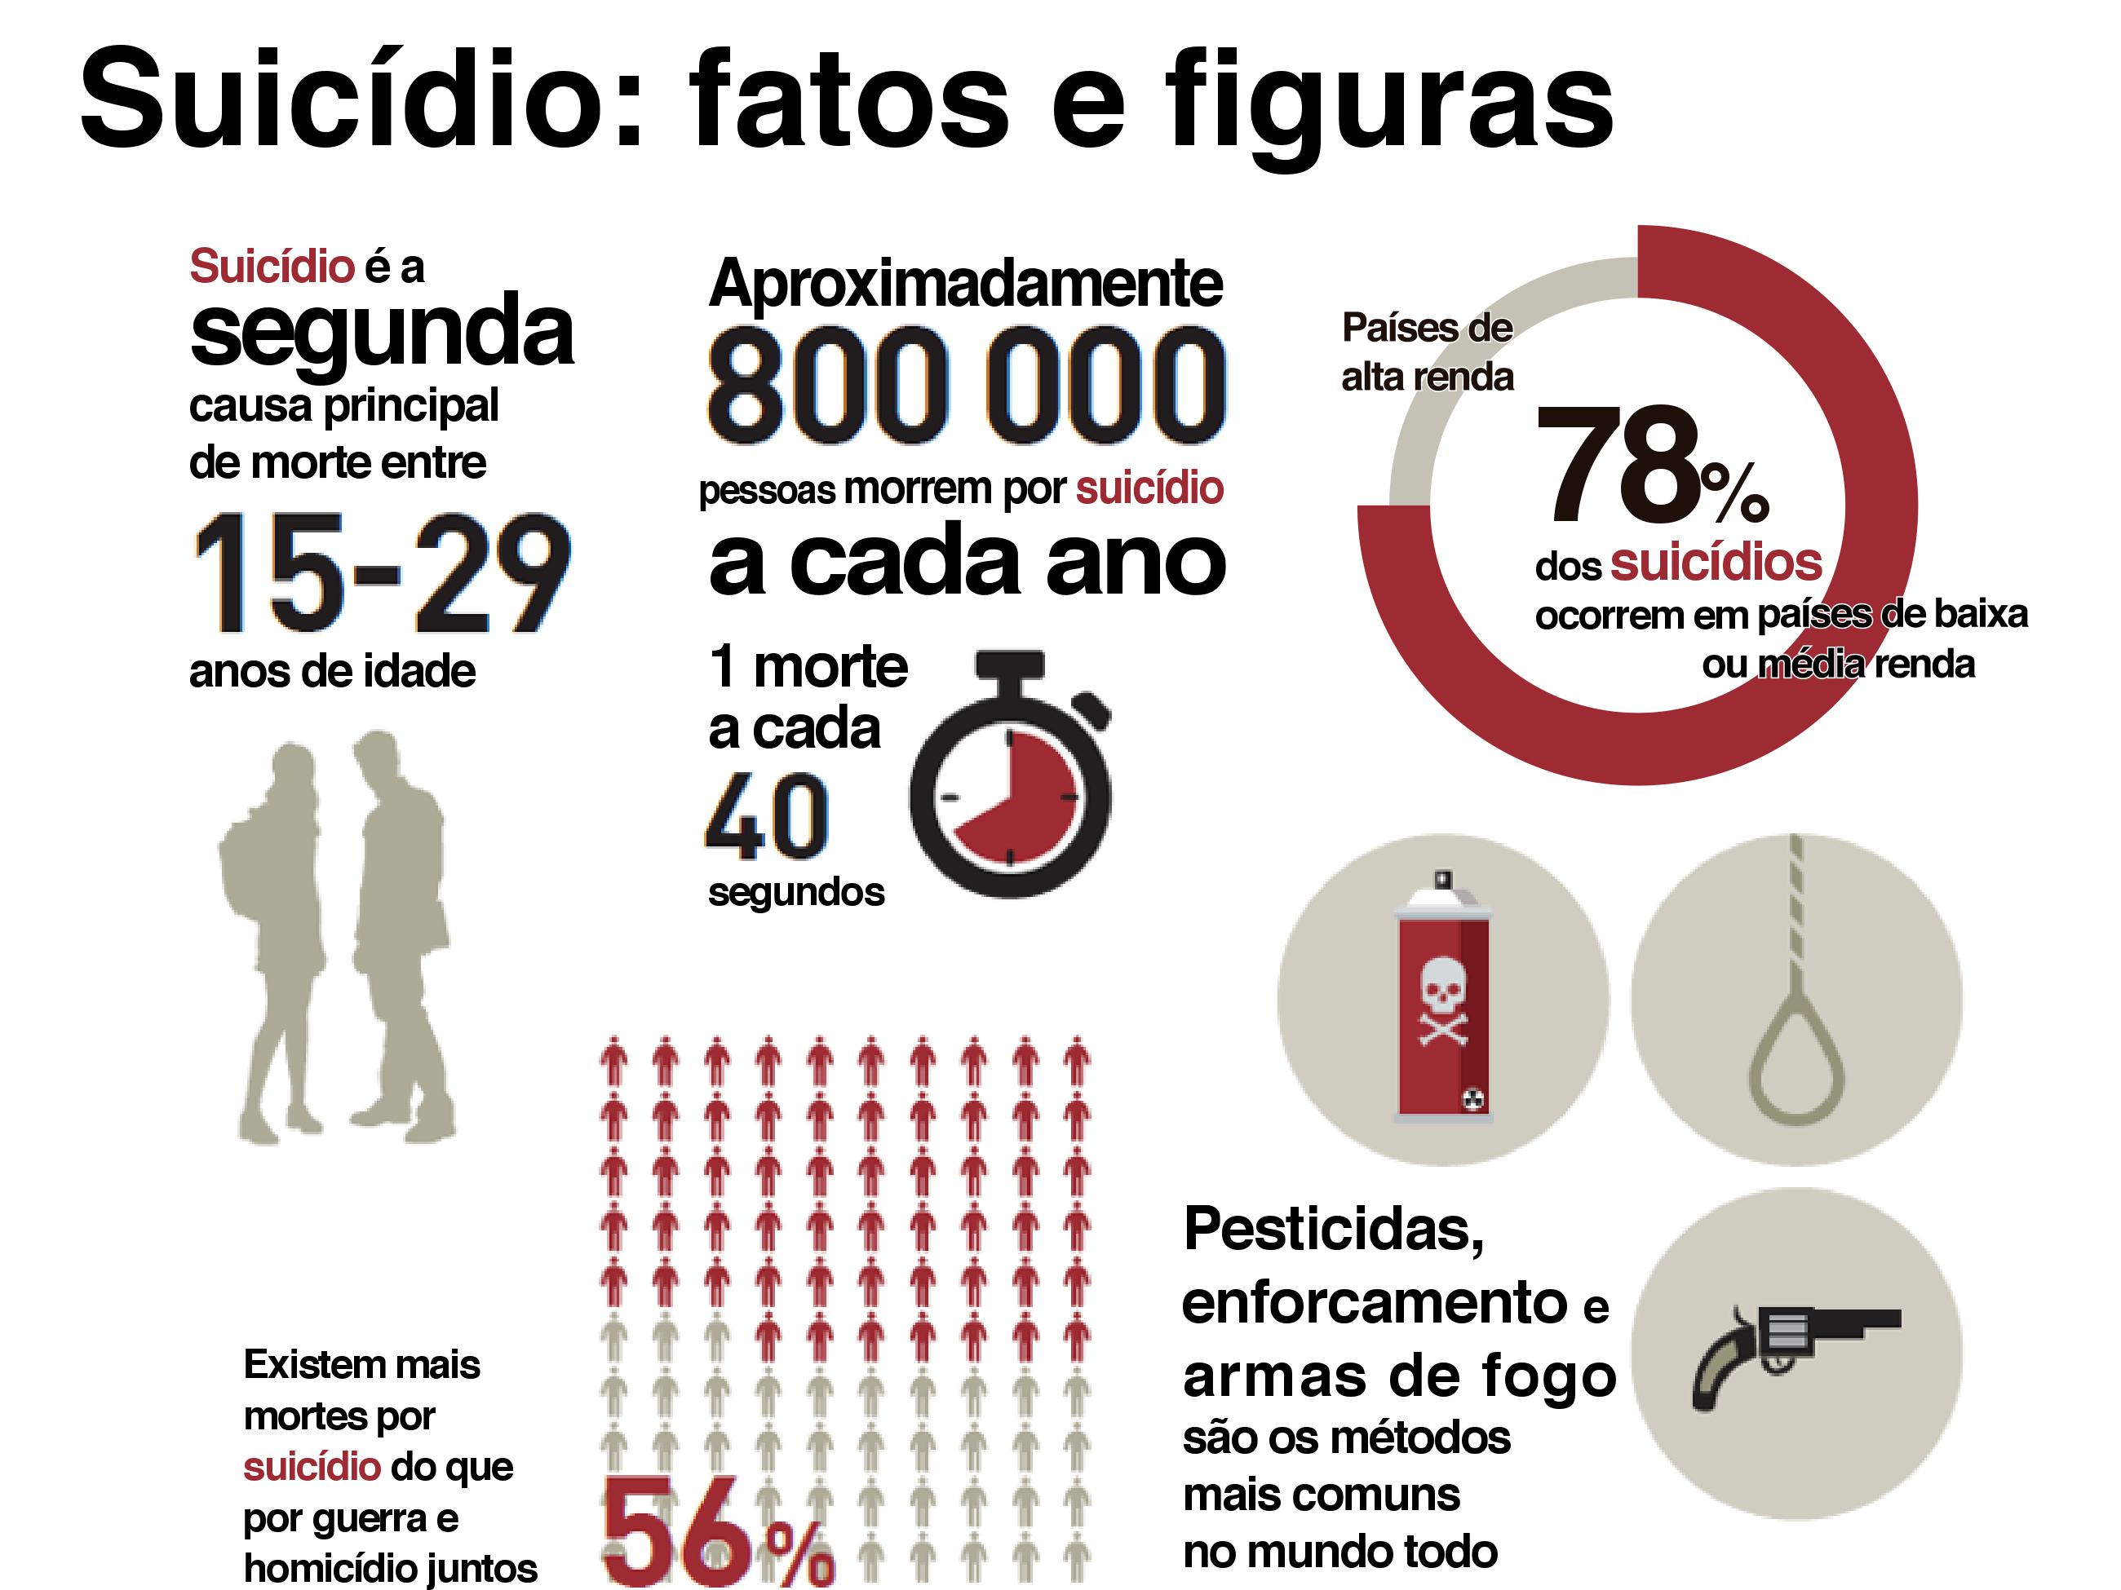
Notes:
Why is suicide a public health concern
Close to 800 000 people die due to suicide every year. Every suicide is a tragedy that affects families, communities and entire countries and has long-lasting effects on the people left behind.
It was the second leading cause of death in 15–29-year-olds globally in 2015.
There are indications to suggest that for every suicide there are more than 20 others attempting suicide.
78% of global suicides occurred in low- and middle-income countries in 2015.
In high-income countries men are three times more likely to die by suicide than women. In low- and middle-income countries men are 1.5 times more likely to die by suicide than women.

Slide 64
Notes:
Direct participants to the master chart and read through the common presentations of people with self-harm/suicide.
Emphasize that there are two points of entry for people with self-harm/suicide.
Either you see them during an emergency suicide attempt or act of self-harm.
or
You assess them for self-harm/suicide whilst assessing for other MNS conditions, chronic pain or acute emotional distress.

Slide 65
Notes:
Assessing someone in an emergency state requires that you medically stabilize them first and ensure their safety before conducting a more thorough assessment.
Assessing someone with thoughts, plans or acts of self-harm/suicide requires that you explore:
any plans
risk factors
protective factors.

Slide 66
Fatores de risco
Fatores de risco
Individuais
Relaciona-mentos
Comunidade
Sistemas de saúde (sociedade em geral)
Notes:
Risk factors
In pairs, ask participants to list two risk factors under each heading. Then show the slides and discuss.

Slide 67
Fatores de risco
Individuais
Tentativas anteriores de suicídio
Uso prejudicial de álcool
Perdas financeiras
Dor crônica
Histórico familiar de suicídio
Sofrimento emocional agudo
incluindo sentir-se impotente, sem esperança, baixa autoestima, culpa e vergonha
Presença de outros transtornos MNS, como depressão
Sistemas de saúde (sociedade em geral)
Dificuldades em acessar os cuidados de saúde e receber os cuidados necessários
Fácil acesso a meios para o suicídio
Reportagem inadequada na mídia que sensacionaliza o suicídio e aumenta o risco de suicídios “imitadores”
Estigma contra pessoas que buscam ajuda para comportamentos suicidas
Notes:
Explain the different kinds of risk factors a person may have.
Risk factors
Ask participants to turn to the person sitting on their right.
In pairs, ask participants to list two risk factors under each of the following headings:
individual risk factors
relationship risk factors
community risk factors
health systems risk factors.
Give participants 10 minutes to discuss and 10 minutes to present back to the group.
Then show the slides and discuss.
Explain that individual risk factors include:
If the person has previous self-harm/suicide attempts.
Have they experienced losses – personal or financial?
Do they use substances?
Do they have a family history of suicide?
Are they experiencing acute emotional distress – feeling hopeless, helpless, shame etc.?
Are they suffering with chronic pain?
Do they have another priority MNS condition?
State that the risk of suicidal behaviour increases with co-occurring mental disorders, i.e. individuals with more than one mental disorder have significantly higher risk of self-harm/suicide.(Source: WHO: Preventing suicide: A global imperative; 2014.)
Explain that health systems and people’s experiences of health systems also impact on their risk of self-harm/suicide. As you talk through the points on the slide (as described below) facilitate a group discussion on why these may be risk factors?
If people have thoughts/plans of self-harm/suicide, it is a risk if they cannot access health care when needed.
There is a greater risk of self-harm/suicide if in society there is easy access to means of suicide (pesticide, guns etc.).
Society’s attitude and stigma towards suicide and people who seek help for self-harm/suicide can also act as a risk factor for self-harm/suicide.
(Source: WHO: Preventing suicide: A global imperative; 2014.)

Slide 68
Fatores de risco
Relacionamentos
Uma pessoa que tenha uma sensação de isolamento e/ou distanciamento social
Abuso
Violência
Relações conflitantes
Comunidade
Guerras e desastres
Estresse de aculturação (como entre indígenas ou pessoas desalojadas)
Discriminação e estigmatização
Notes:
Explain that relationship problems are a risk factor for self-harm/suicide including:
a sense of isolation
abuse
violence
fights/conflicts.
Explain that what is happening in the wider community can also act as a risk factor for self-harm/suicide – such as war, disaster, stress and discrimination.
(Source: WHO: Preventing suicide: A global imperative; 2014.)
Ask participants to reflect on why these may be risk factors and facilitate a brief discussion.
Stress that risk factors can change over time. Therefore, they should be reviewed at follow-up visits, especially when the symptoms and/or the situation worsens.

Slide 69
Fatores de risco
Individuais
Fatores de proteção
Relacionamentos
Saúde
Comunidade
Notes:
Risk factors increase the risk that the person may take their own life or engage in acts of self harm.
Protective factors decrease the risk.
In pairs spend five minutes brainstorming possible protective factors.
Receive feedback from the group discussions.

Slide 70
Fatores de risco
Individuais
Comunidade
Fatores de proteção
Comportamentos anteriores
Envolvimento da comunidade
Crenças religiosas e culturais
Relacionamentos
Saúde
Relações familiares e sociais
Notes:
Protective factors are:
Previous coping – have they felt like this before? If so, how did they cope, what did they do? What helped them? Will it help them again?
Community involvement – are there family members, friends, community members who can help, listen, and support them?
Religious, cultural beliefs – access to spiritual/religious leaders, important community people who can support them? Do they have beliefs that give them hope?
Family and social relationships – are there relationships or people who give them hope and sense of having a future?

Slide 71
Notes:
Use the mhGAP-IG algorithm to decide if Nada attempted a medically serious act of self-harm?
Explain that assessment must happen very quickly in an emergency.

Slide 72
Notes:
Once the person is medically stable and in a safe environment then return to the assessment algorithm and continue with the assessment steps.
Does Nada have an imminent risk of self-harm/suicide?
Facilitate a brief group discussion to answer this question.

Slide 73
Perguntando sobre autoagressão/suicídio
Ao perguntar à pessoa sobre autoagressão ou suicídio, a pergunta deve ser feita com uma transição apropriada de um ponto anterior que leve à questão.
Ninguem induz suicidio ao perguntar sobre suicidio
Uma alternativa é começar perguntando sobre se a pessoa acharia bom morrer, explorando os sentimentos negativos primeiro para então perguntar se a pessoa tem algum plano para se matar:
Eu vejo que você está passando por um período muito difícil. Na sua situação, muitas pessoas sentem que a vida não vale a pena. Você já se sentiu assim antes?
Notes:
Explain to the group that questions about self-harm/suicide must follow an appropriate line of questioning.
For example, do not ask, "Do you have a headache?" and next, "Do you want to kill yourself?” Instead, when the person is talking about their feelings of sadness or hopelessness, make the transition to asking about any thoughts or plans of self-harm/suicide.

Slide 74
Perguntas gerais sobre pensamentos e planos
Quais são alguns dos aspectos da sua vida que fazem não valer a pena viver?
Quais são alguns dos aspectos da sua vida que fazem valer a pena viver?
Você já desejou terminar sua própria vida?
Você já pensou em se machucar?
Como você se machucaria? O que você faria?
Notes:
Talk through the suggested questions on the slide.
Facilitate a brief brainstorming discussion to ensure that these examples of general questions are culturally appropriate.

Slide 75
Perguntas específicas
Quais pensamentos especificamente você tem tido?
Há quanto tempo você tem esses pensamentos?
Quão intensos eles têm sido? Quão frequentes? Quanto tempo eles têm durado?
Esses pensamentos aumentaram recentemente?
Você tem um plano de como você morreria ou se mataria?
Como é esse plano? Onde você faria isso? Quando você faria isso?
Você tem os meios para realizar este plano?
Quão fácil é para você se apossar da arma/corda/pesticida, etc. (os meios)?
Você já realizou alguma tentativa? Se sim – o que aconteceu?
Notes:
Read out the list of specific questions on the slide.
Facilitate a brief brainstorming discussion to ensure that these questions are culturally appropriate.
Have participants generate their own list of specific questions. Make a note of their questions. Keep the list in full view so participants can use those questions in upcoming role plays.

Slide 76
Perguntas para explorar fatores de proteção
Quais são alguns dos aspectos da sua vida que fazem valer a pena viver?
Como você lidou anteriormente quando esteve sob estresse semelhante?
O que te ajudou no passado?
A quem você pode pedir ajuda? Quem vai te ouvir? Com quem você se sente apoiado?
Quais alterações nas suas circunstâncias vão mudar sua opinião sobre se matar?
Notes:
Whilst asking questions about any plans or thoughts that people may have it is a good time to ask about potential protective factors.
Brainstorm with the group more questions that are culturally relevant.
Continue with the assessment algorithm.

Slide 77
Notes:
Explain that previous behaviour is a strong predictor of future behaviour, therefore it is important to ask about any previous acts of self-harm or suicide attempts.
If they have had previous acts of self-harm/suicide then this is also an opportunity to ask what helped them survive those previous act/attempts.
How did they cope with those feelings? Can they do the same thing this time?
When they have felt like this before what did they do? How did they cope then? Can they do this again?

Slide 78
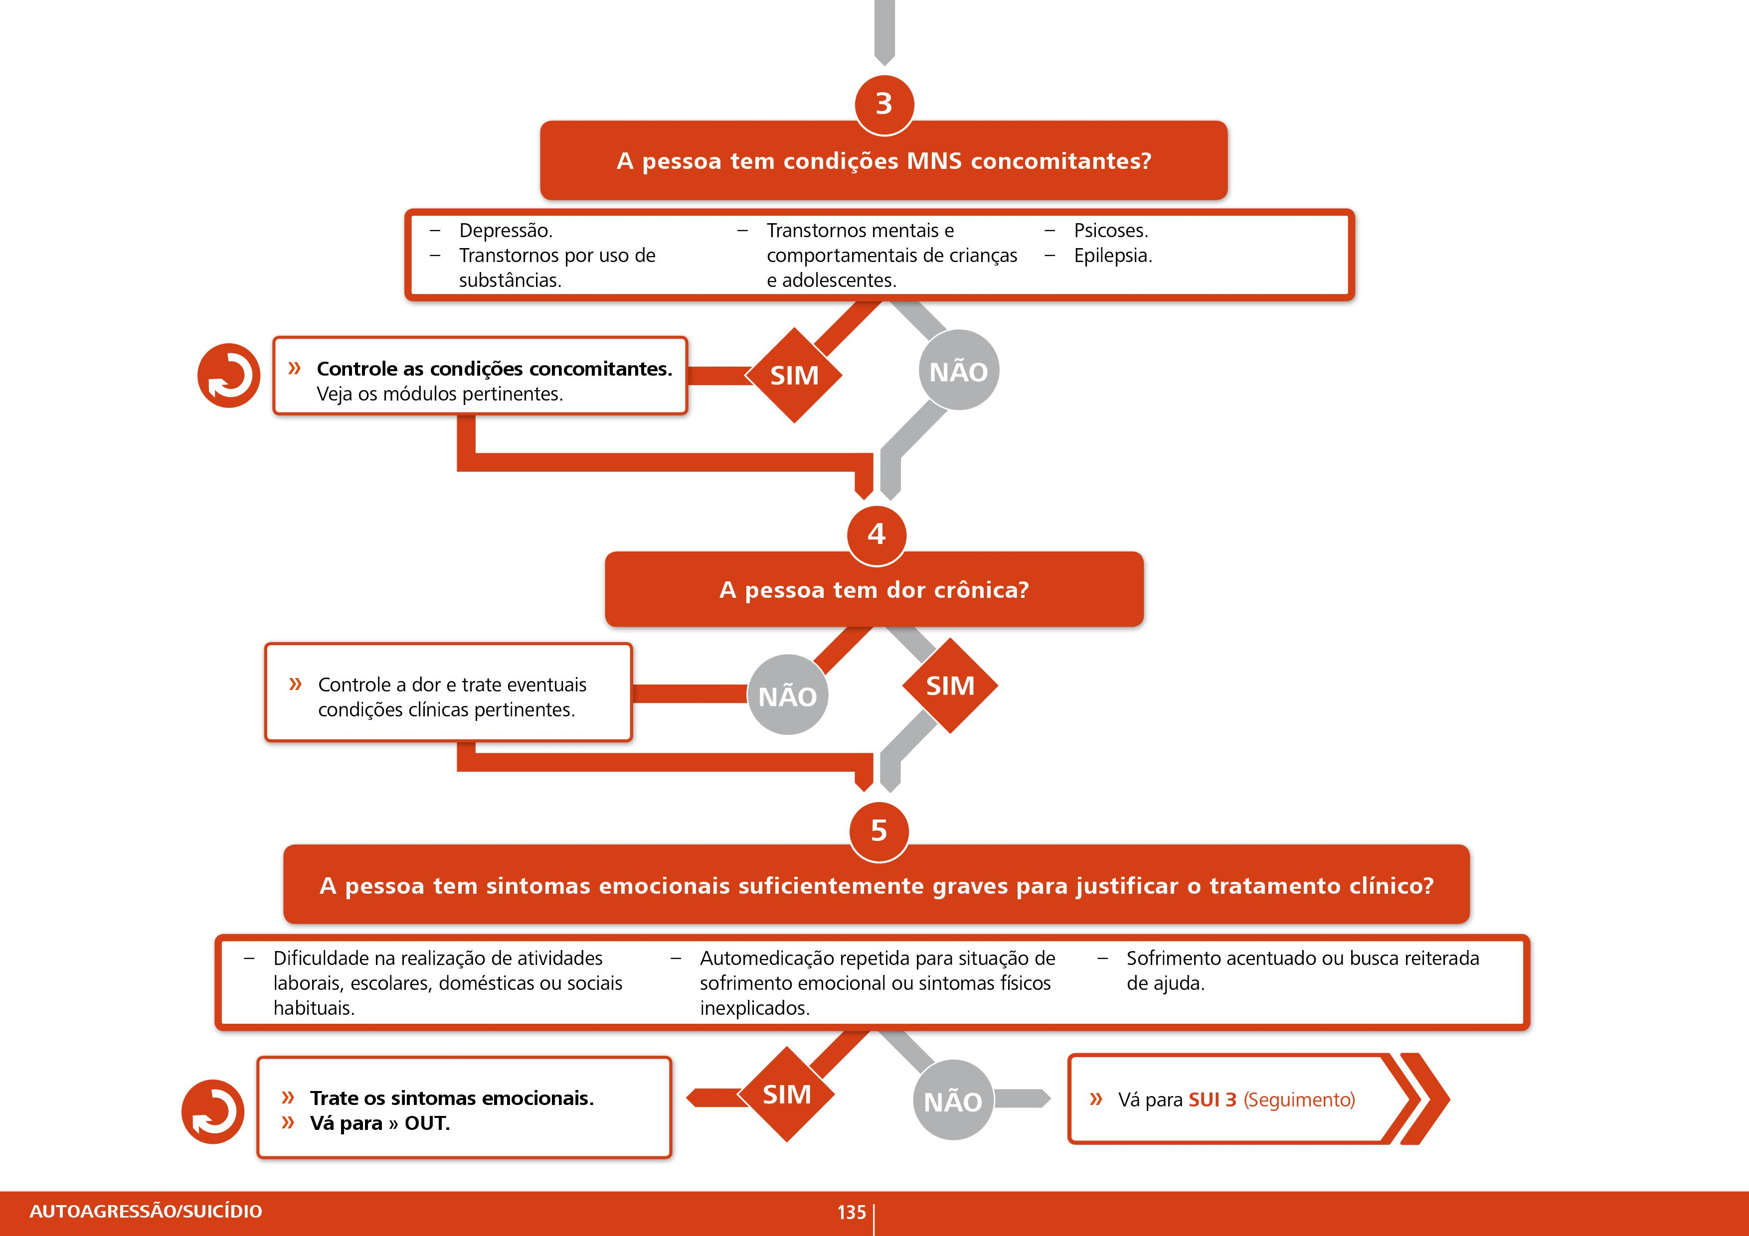
Notes:
Whilst assessing for suicide it is essential to assess for:
Other concurrent MNS conditions.
Chronic pain due to HIV/AIDS, cancer etc.
Emotional distress – this can be due to loss of a loved one, loss of employment, intense family conflict, problems at school, intimate partner violence, physical or sexual abuse or uncertainty about gender and sexual orientation etc.
If there are other concurrent MNS conditions, chronic pain or acute emotional distress then treat these conditions and go to the relevant modules in the mhGAP-IG.

Slide 79
INTERVALO

Slide 80
Notes:
Management of medically serious acts of self-harm/suicide
In case of medically serious act of self-harm/suicide, the person should be put in a secure and supportive environment at the health-care facility.
In the video, Nada cut her wrist but what are the other methods of self-harm/suicide people can use?

Slide 81
Notes:
Ask the group what interventions could we use in the management of self-harm/suicide?

Slide 82
Oferecer e ativar suporte psicossocial
Tratar quaisquer transtornos MNS simultâneos, dor crônica ou sofrimento emocional
Apoiar os cuidadores
Cuidar/criar um ambiente seguro para a pessoa que tenha cometido autoagressão/suicídio
Psicoeducação
ENCAMINHAR para um especialista em saúde mental
Notes:
Explain that the key to the management of self-harm/suicide is to:
Ensure the person does not have access to means.
Support their carers.
Mobilize family and friends to support and make them feel safe.
Focus on protective factors.
Offer psychoeducation to ensure they understand it is best to talk about these feelings and identify people that they can turn to when one is feeling this way.
It is important to treat any underlying MNS condition, chronic pain and emotional distress.
Due to the seriousness of self-harm/suicide ALWAYS refer to and consult a mental health specialist when available.

Slide 83
Manejo: Condições concorrentes
Se houver um transtorno MNS simultâneo, por ex. depressão, transtorno por uso de álcool, gerencie de acordo com o MI-mhGAP para autoagressão/suicídio e também para a condição mhGAP.
Se houver dor crônica, você precisa controlar a dor. Consulte um especialista em dor, se necessário/disponível.
Se a pessoa não tiver um transtorno mhGAP, e mesmo assim apresentar sintomas emocionais graves, gerencie conforme explicado no Módulo: Outros problemas importantes de saúde mental.
Notes:
Carer support, psychosocial support, psychoeducation.
Again, where possible, refer to and consult a mental health specialist.

Slide 84
Notes:
Direct participants to page 137 of the mhGAP-IG Version 2.0 and ask a volunteer from the participants to briefly talk through the different interventions in detail, answering any questions the group may have.
Remind participants that it is essential to ensure that the person is in a safe and quiet environment when talking about self-harm/suicide.
Remind participants to involve carers, where possible, in the assessment and management of the person with self-harm/suicide.

Slide 85
Notes:
Direct participants to continue to read through the psychosocial interventions in the mhGAP-IG. Ask for a different volunteer to continue reading out loud.
Highlight the points listed under activating psychosocial support.
Explain that by assessing for protective factors, they have already started to “explore reasons and ways to stay alive”.
When exploring for reasons and ways to stay alive, one should really listen to the person and try to understand what is the most important for them and avoid giving your own opinions.

Slide 86
ATIVIDADE 02 ROLEPLAY: Avaliação e Intervenção
treinamento de avalição/intervençao em caso de Auto Agressão
Pratique usando o MI-mhGAP para avaliar e cuidar de alguém com autoagressão ou tentativa de suicídio
Notes:
See SUI supporting materials role play 1.
Print three different instruction sheets for the participants playing different roles.
Ensure the person playing the role of the observer also has a competency assessment form (see ToHP training forms) in order to assess the participants.
Duration: 30 minutes.
Purpose: This role play gives participants an opportunity to practise using the mhGAP-IG to assess for possible self-harm/suicide.
Situation: A young man has come to be checked over after having a motorcycle accident. The health-care provider is worried he may have been suicidal at the time of the accident.
Instructions:
Divide the participants into groups of three.
Instruct one person to play the role of the health-care provider, one the person seeking help and one the observer.
Distribute the role play instructions to each person depending on their role.
Ensure that the participants keep to the allotted time.

Slide 87
Notes:
Talk through the follow up assessment steps as described on the slide and in the mhGAP-IG
Explain that a person needs to be followed-up with closely as long as there is still a risk of self-harm/suicide.
Different methods can be used to follow-up: scheduling another appointment at the centre, home visits, phone calls, text messages. The appropriateness of these different methods varies depending on cultural acceptability and on the resources available.
Facilitate a brief group discussion about:
Different ways that they could follow up with a person with self-harm/suicide.
Identify any barriers/solutions to providing follow-up.

Slide 88
Revisão
DÚVIDAS
Notes:
Duration: Minimum 15 minutes (depending on participants’ questions).
Purpose: Review the knowledge and skills gained during this training session by delivering MCQs and facilitating a discussion.
Administer the SUI MCQs (see SUI supporting material) to participants.
Discuss the answers as a group.
Facilitate a brief discussion answering any queries or concerns the participants may have.

Slide 89
FIM
Notes:
Duration: Minimum 15 minutes (depending on participants’ questions).
Purpose: Review the knowledge and skills gained during this training session by delivering MCQs and facilitating a discussion.
Administer the SUI MCQs (see SUI supporting material) to participants.
Discuss the answers as a group.
Facilitate a brief discussion answering any queries or concerns the participants may have.

